Slide 1

SWP391: FINAL PROJECT PRESENTATION
House_Rental_Management_System-SWP391
SE1734 - Group 2

Slide 2
Team Member
Team member
Hà Quang Thắng - HE176429 (leader)
Nguyễn Tuấn Anh - HE176694
Trương Tiến Sỹ - HE176623
Dương Thanh Tùng - HE176669
Nguyễn Bá Khánh - HE170920
Phạm Văn Tiến - HE163824
Supervisor: Trần Đình Trí

Slide 3
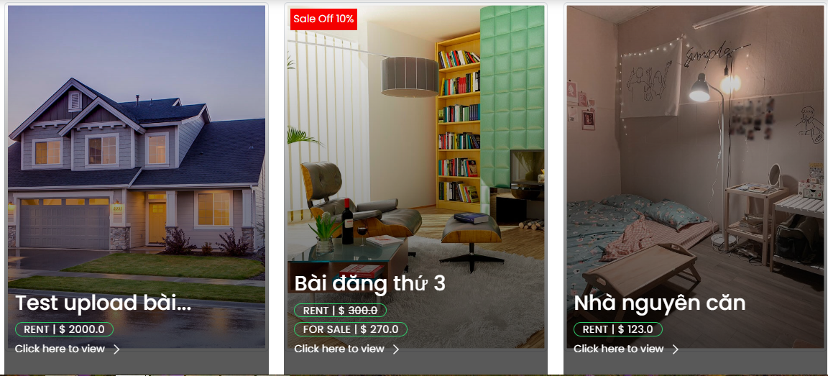
Project Overview
Introduction
The House Rental Management System (HRMS) is a solution that brings tenant (who is looking for house to rent) and landlords (who has available house for rent) closers. Tenant now has a transparent environment to looking for houses that meet their criteria.

Slide 4
Scope and Limits
Product Scope
Area: 63 Provinces of Vietnam
Mediator between Tenant and Landlord
Out of Scope
Payment gate
Accountants
Contract Making
Verify property licensing
Verify civil ID
Real-time integrated message box.

Slide 5



Project Management
Project communication
Online meeting: By the end of weekend (Google Meets and Messenger)
Offline meeting: SWP391 classes

Slide 6
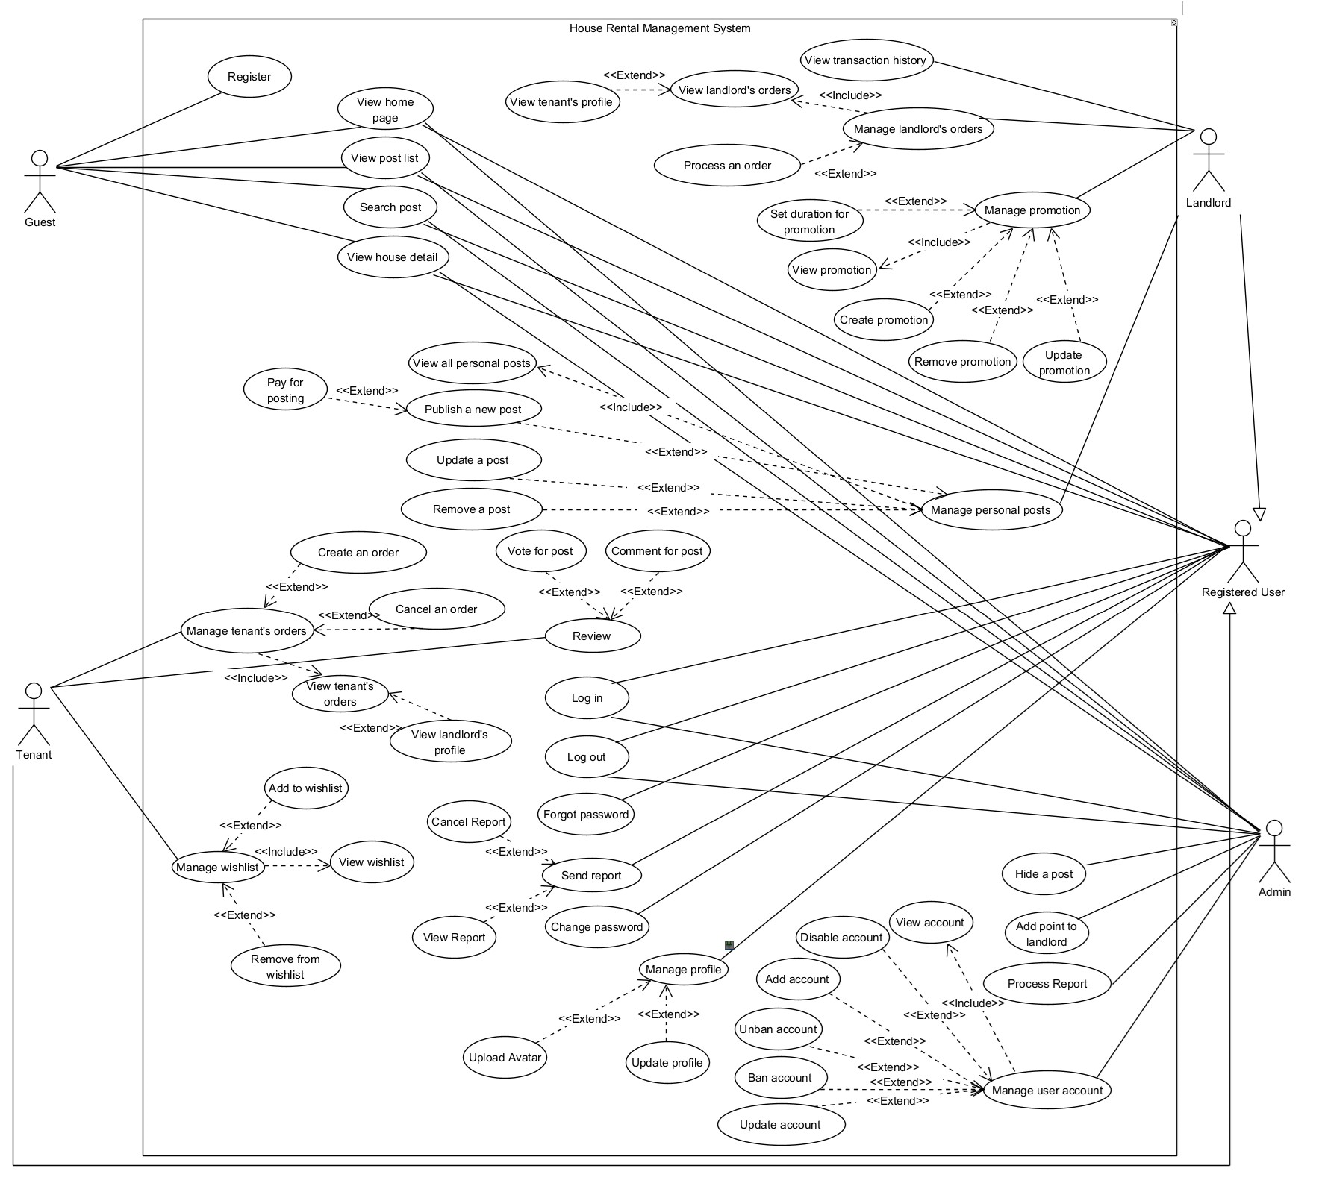
Product Requirements Use Case Diagrams

Slide 7
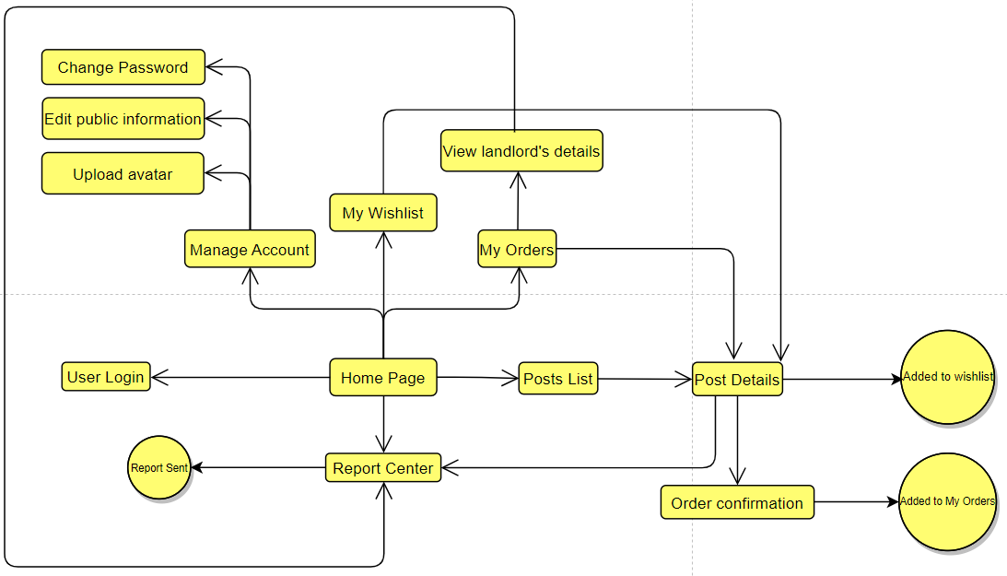
Screenflow for Tenant Role

Slide 8
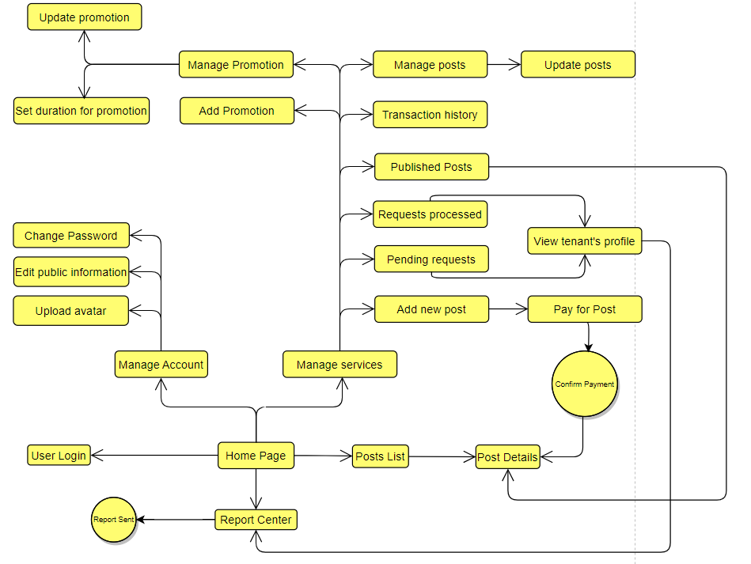
Screenflow for Landlord Role

Slide 9
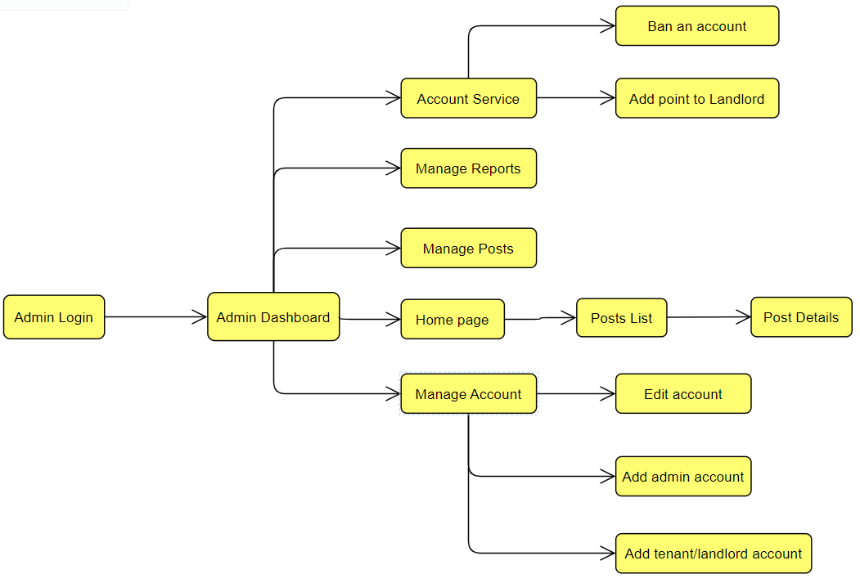
Screenflow for Admin Role

Slide 10
Product Requirements Main Screen UI Design
Screenshots for the main screens of House Rental Management System
Main Web screen: Home Page
Main Admin screen: Dashboard
Tenant Manage Account
Landlord Manage Service

Slide 11
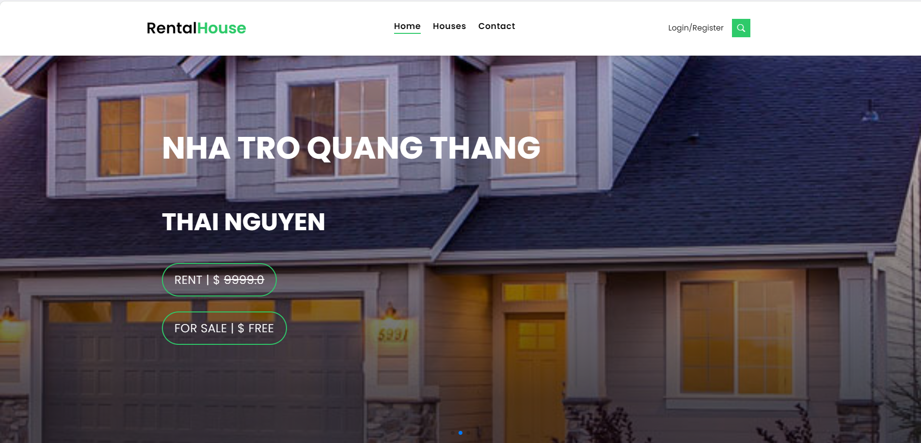
Screen
Home Page

Slide 12
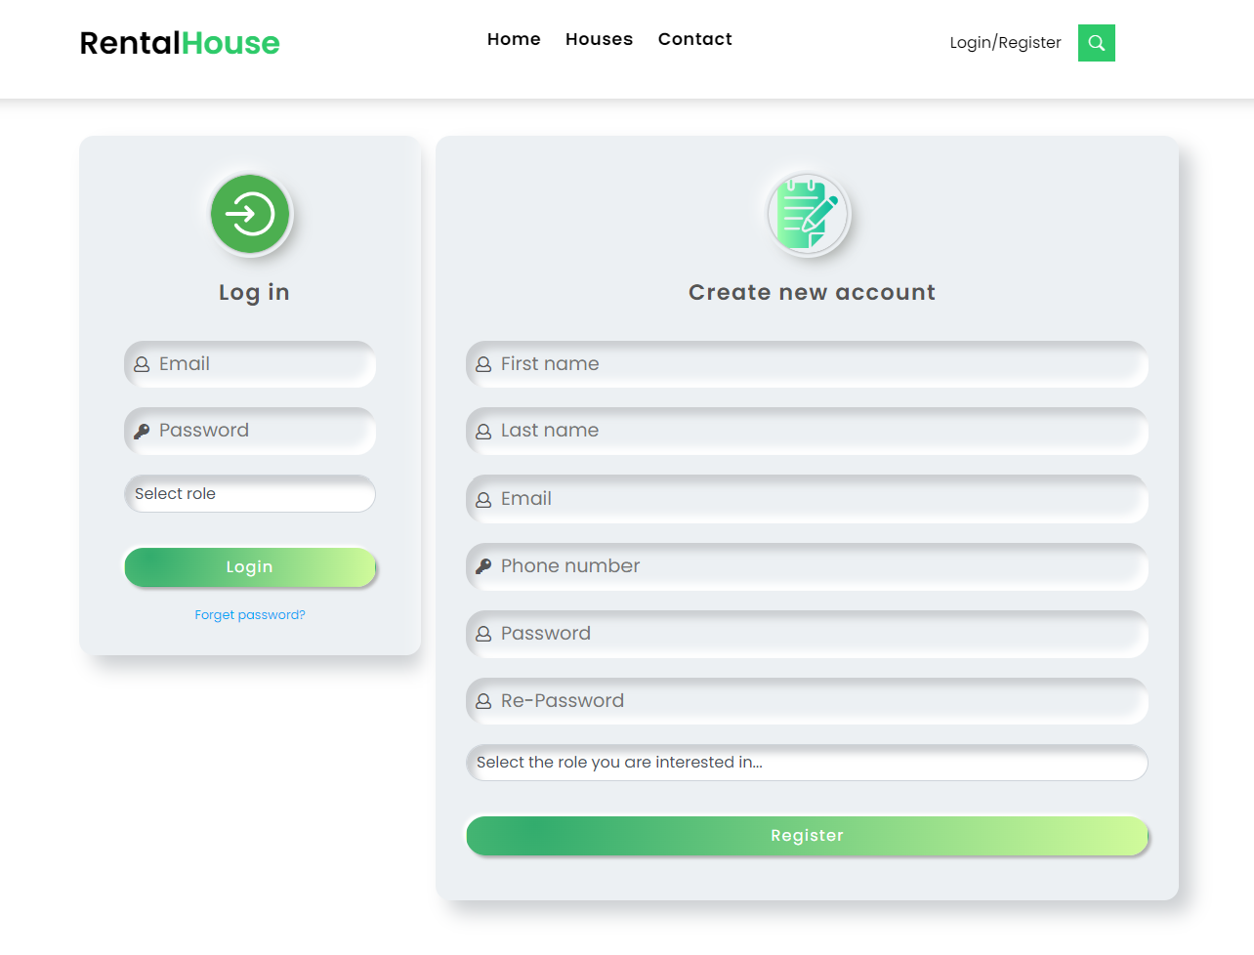
Screen
User Login / Register

Slide 13
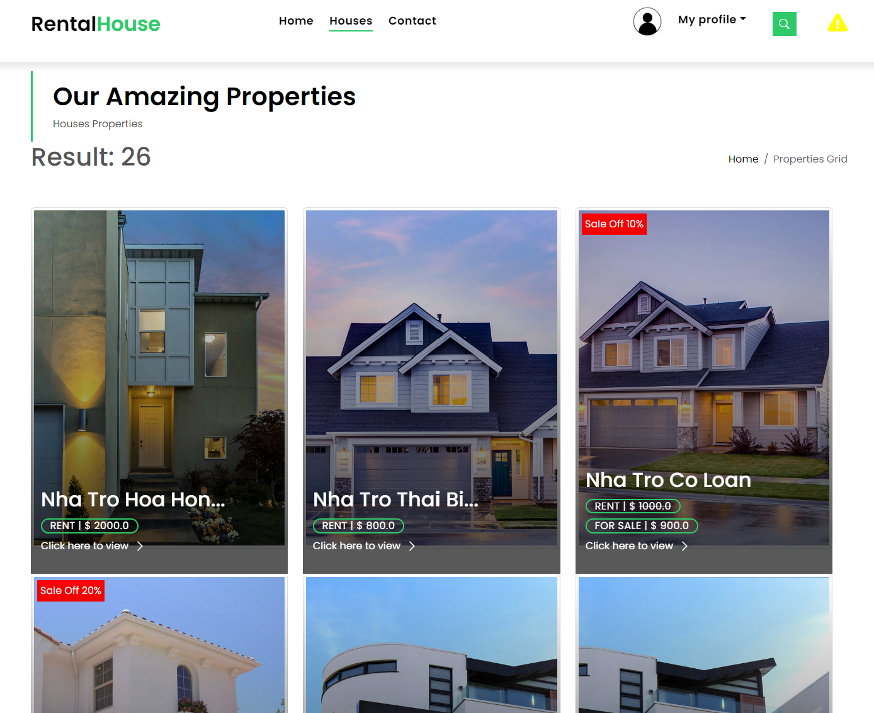
Screen
List of house

Slide 14
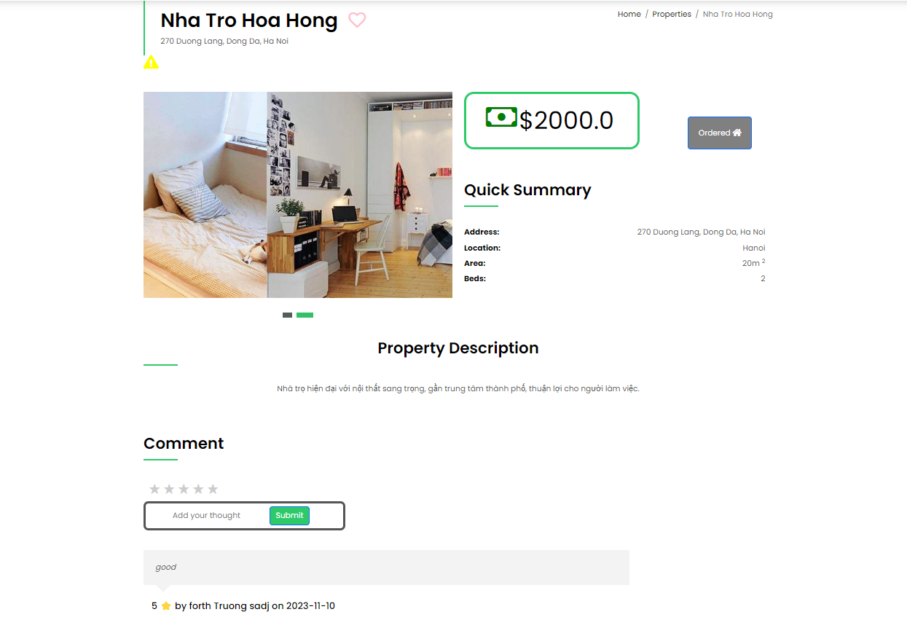
Screen
House Detail

Slide 15
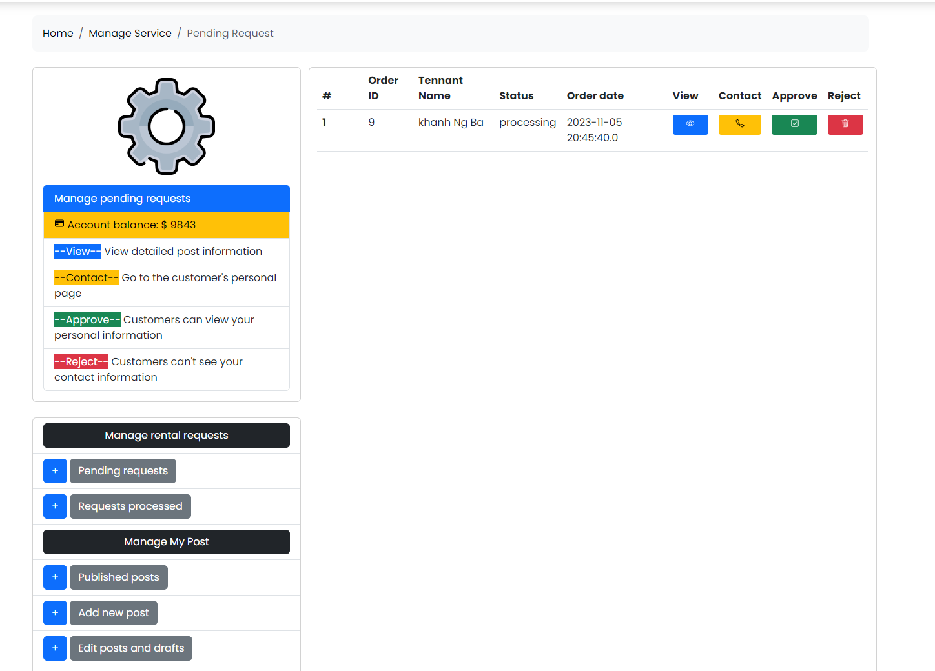
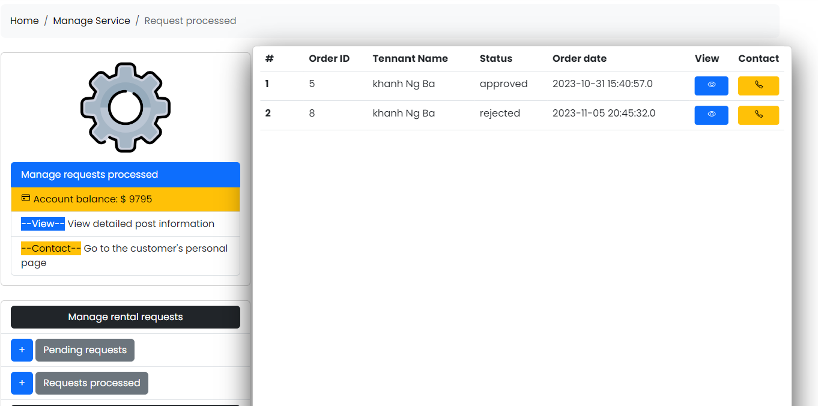
Screen
Request processed
Pending request
Landlord Rental Request Manage

Slide 16
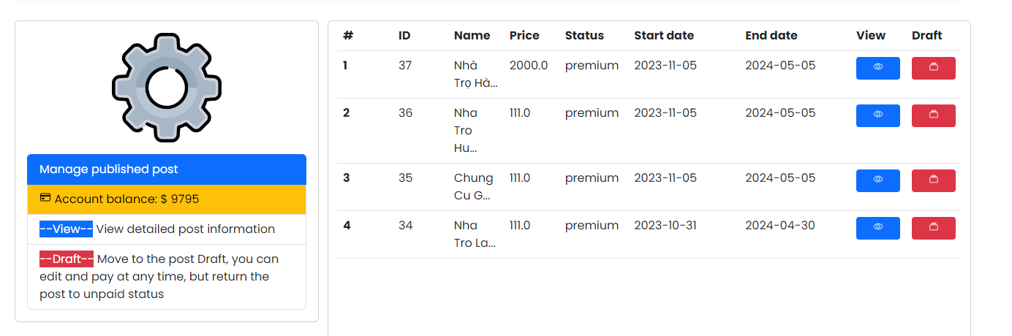
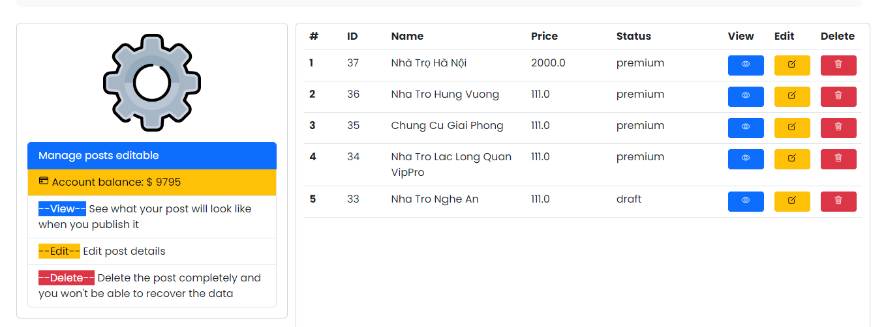
Screen
Published Posts
Edit and Draft
Manage My Post

Slide 17
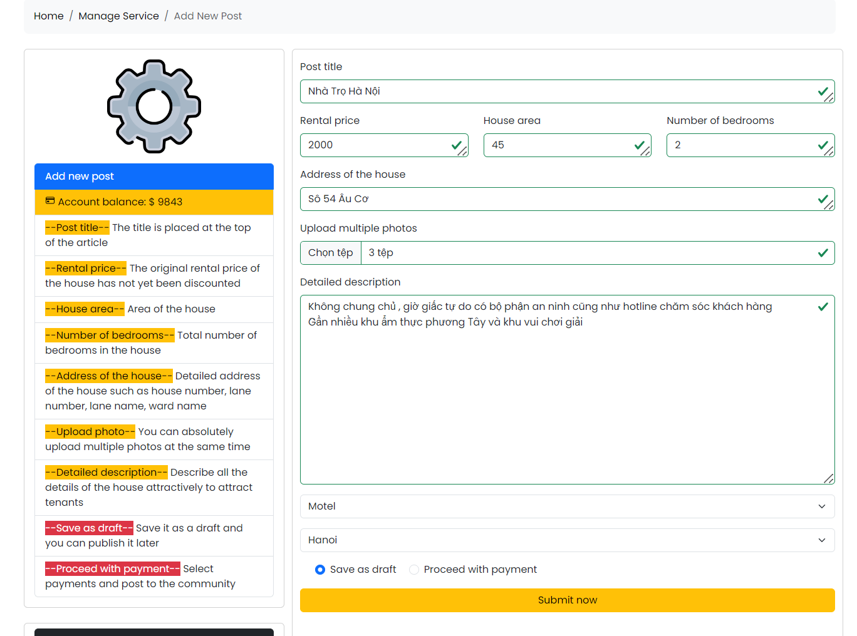
Screen
Add new Post

Slide 18
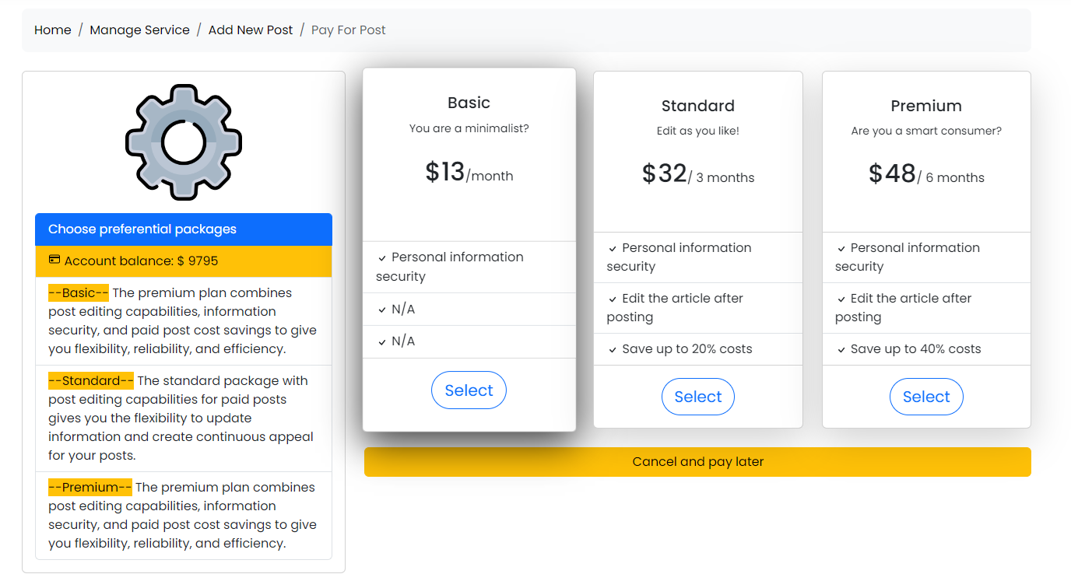
Screen
Pay for Post

Slide 19
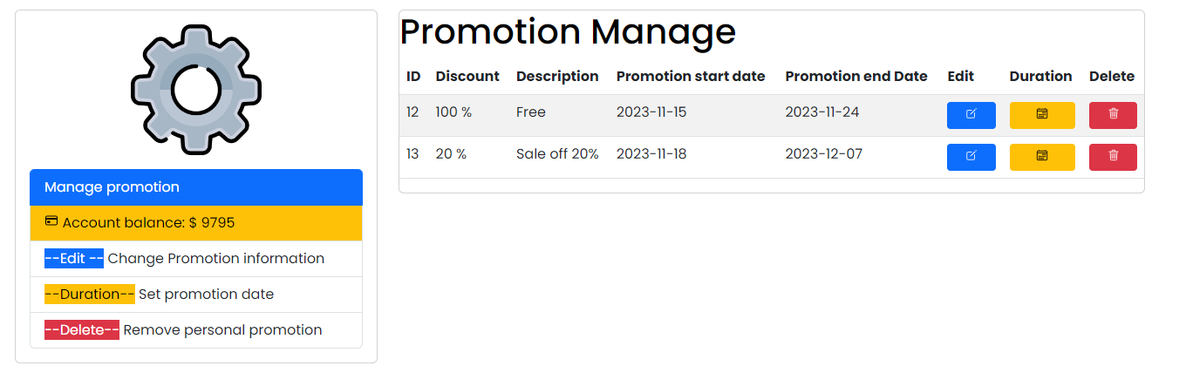
Screen
Promotion Manage

Slide 20
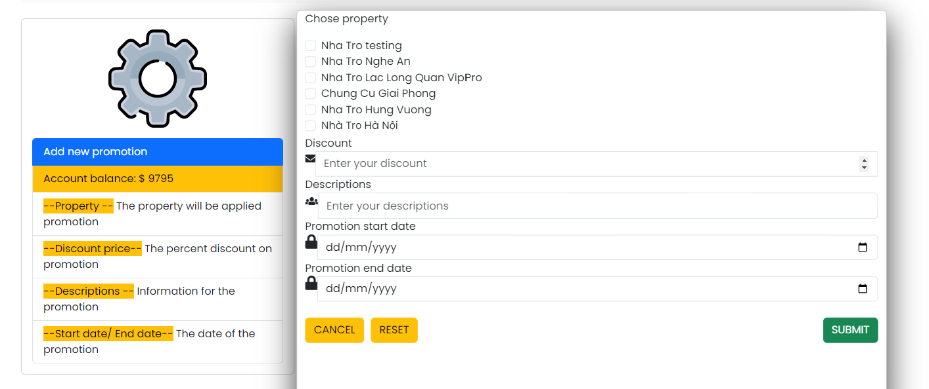
Screen
Add New Promotion

Slide 21
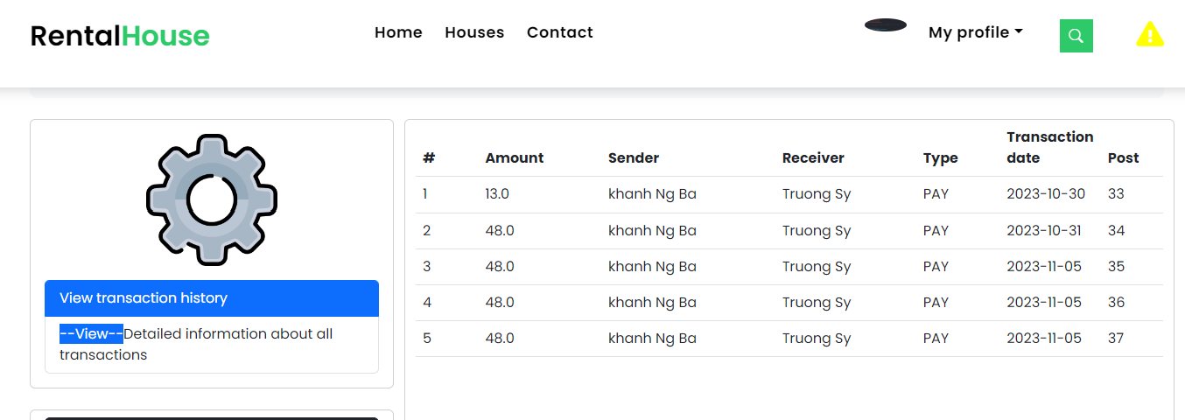
Screen
View Transactions History

Slide 22
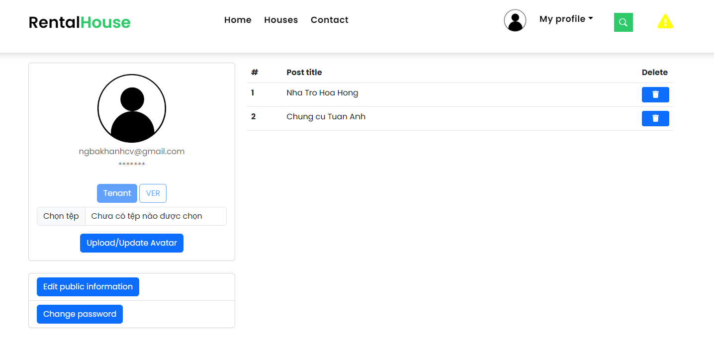
Screen
Tenant WishList

Slide 23
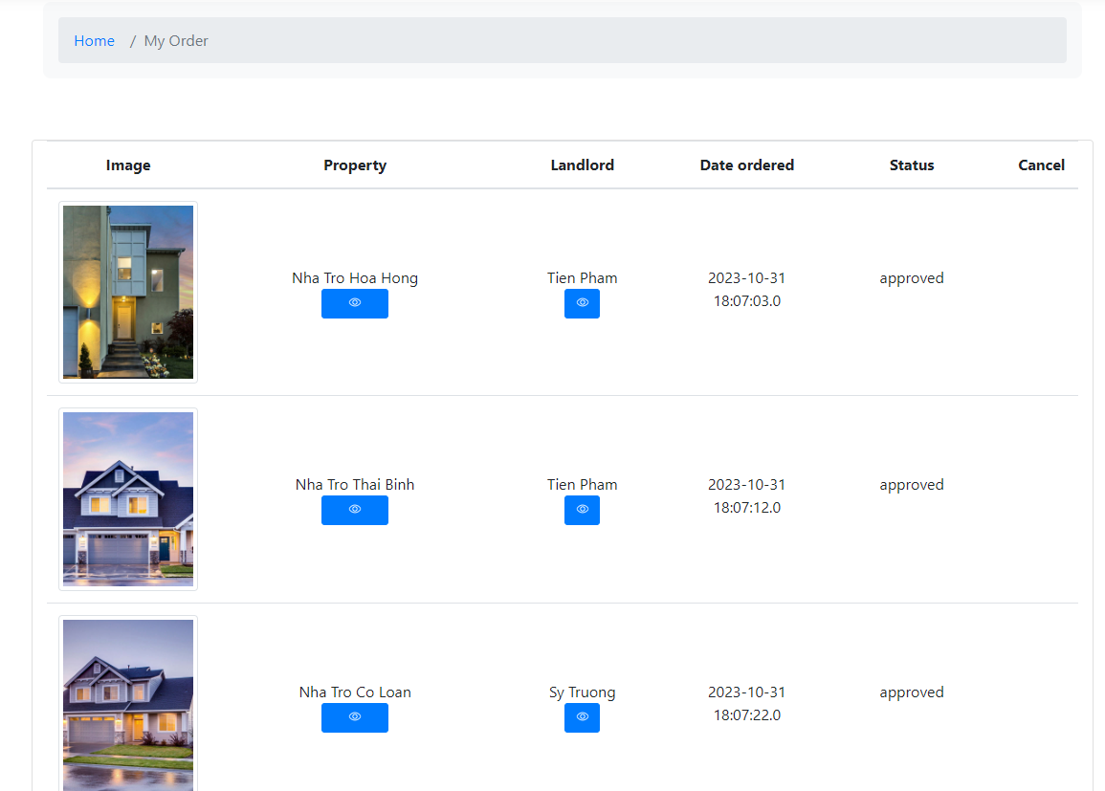
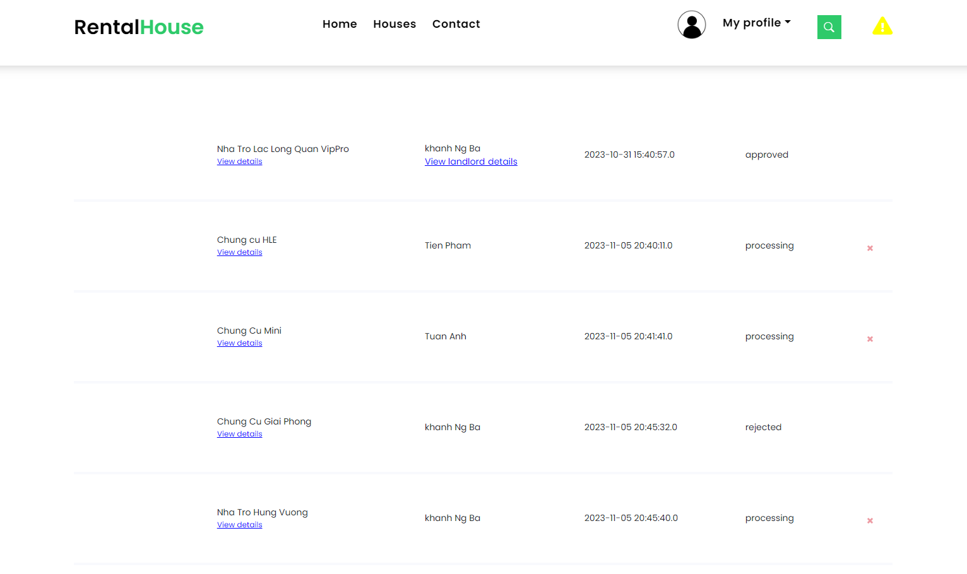
Screen
Tenant Order List

Slide 24
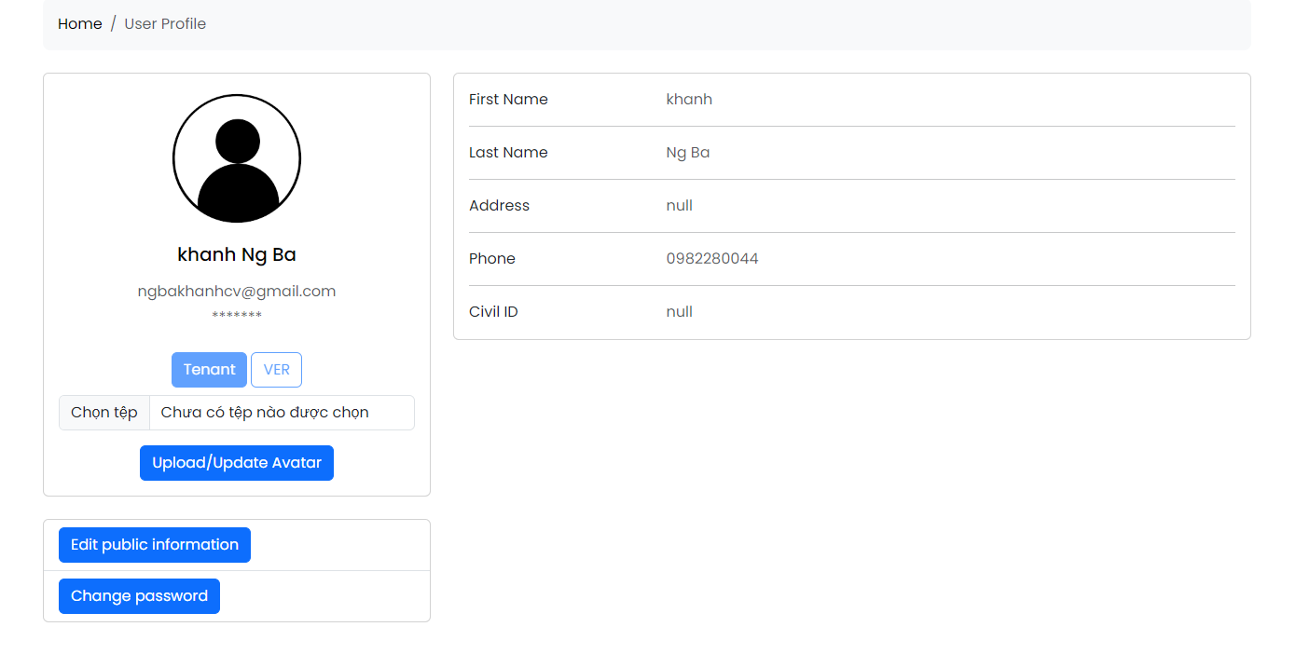
Screen
User Profile

Slide 25
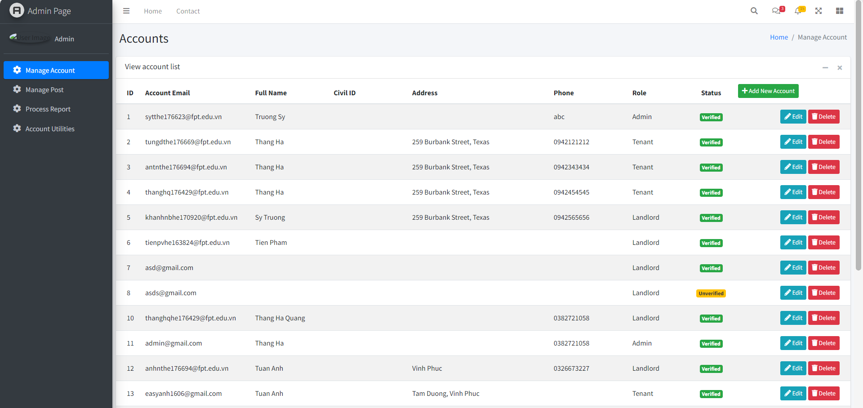
Screen

Slide 26
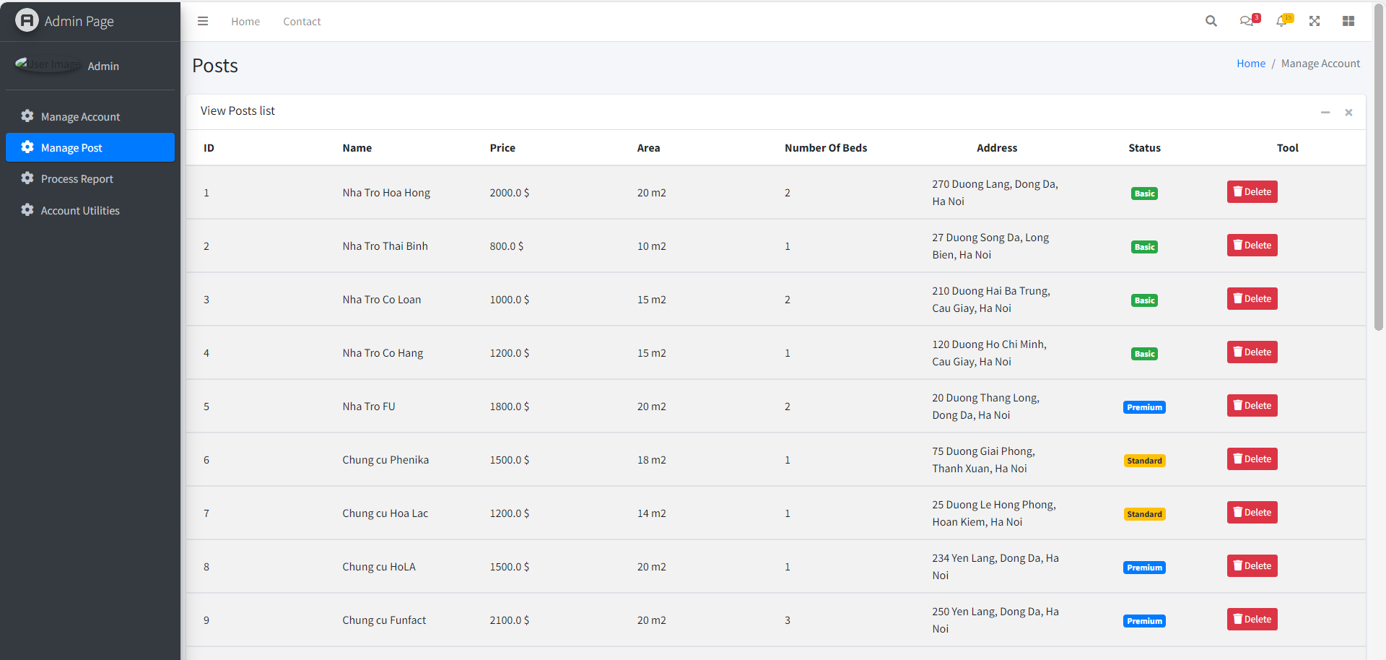
Screen

Slide 27
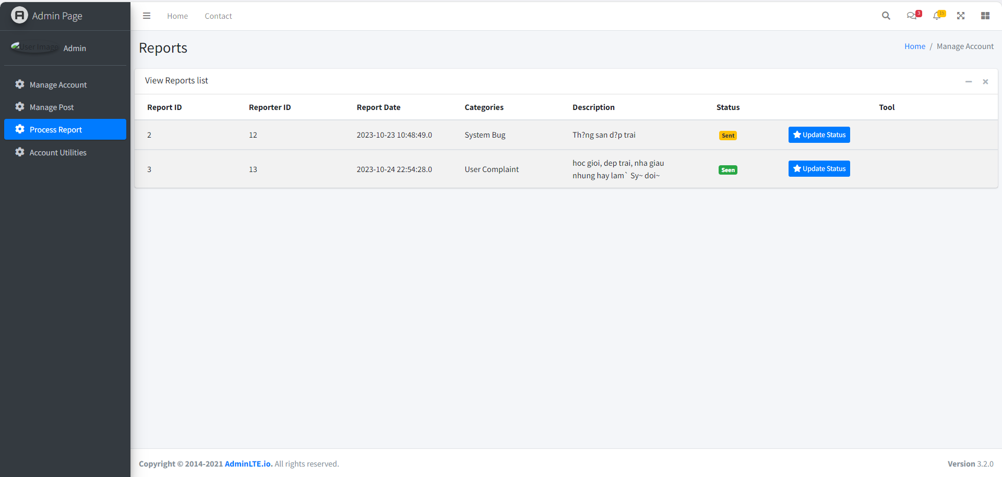
Screen

Slide 28
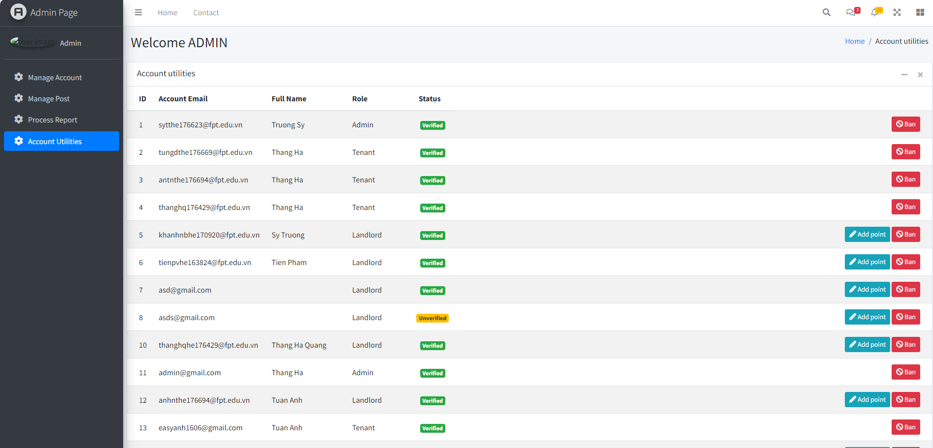
Screen

Slide 29
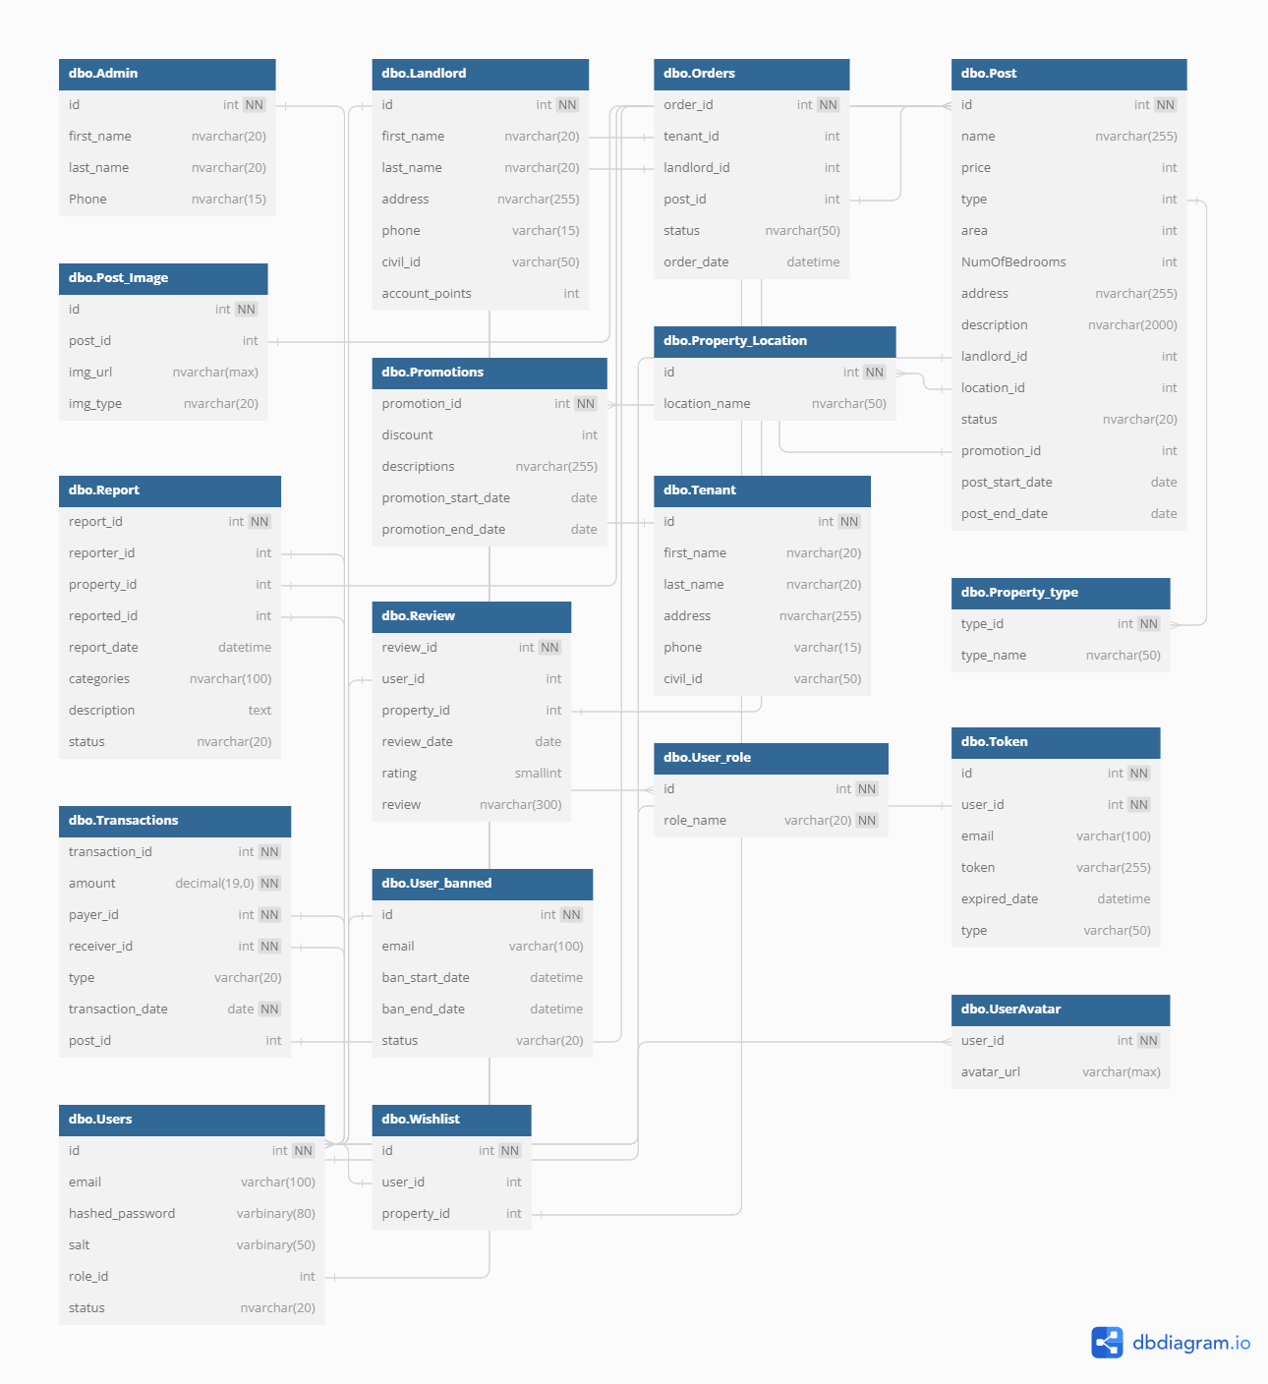
System Design Database Design

Slide 30
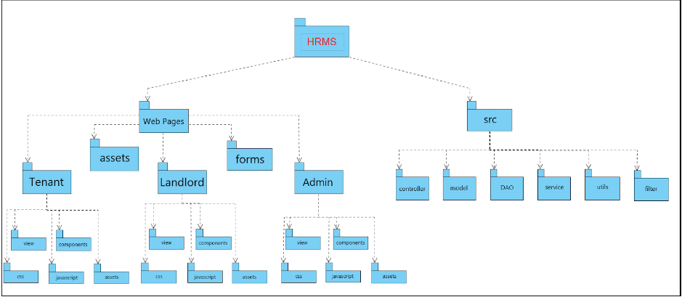
System Design Package Diagram

Slide 31
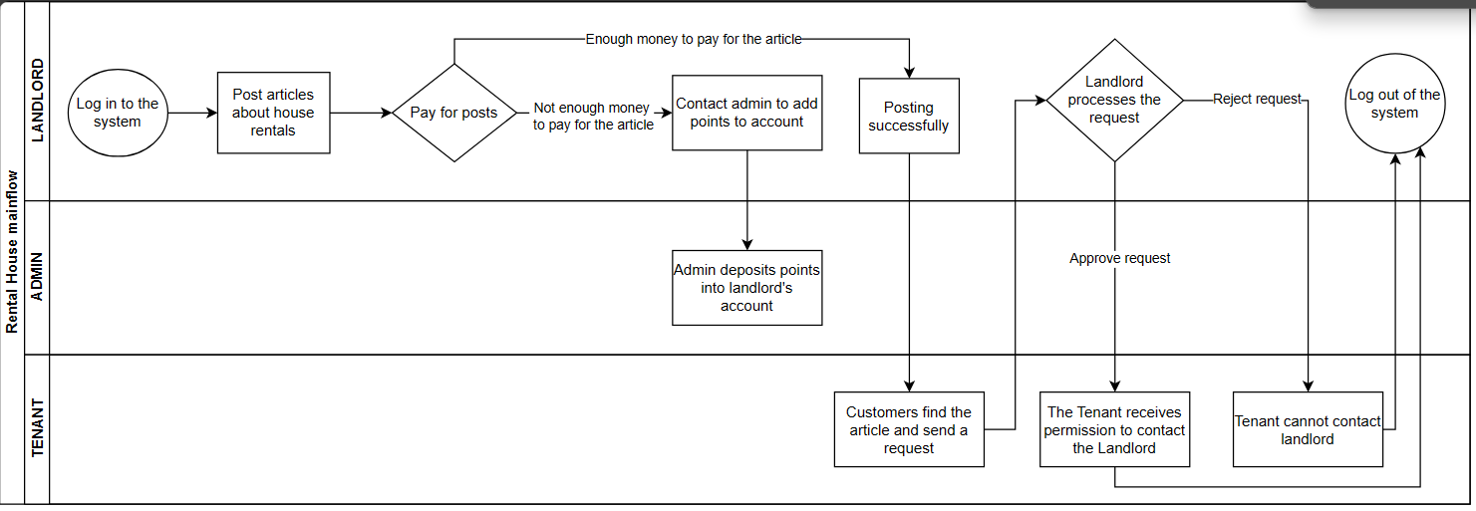
Demonstration

Slide 32


